Slide 1
SAP Exchange Infrastructure
2
Application Environment
Enterprise Service Repository

Slide 2

Enterprise Service Repository
Agenda
PI7.1 Enterprise Service Repository
Overview and concepts
Software components and namespaces
Interface objects
Mapping objects

Slide 3
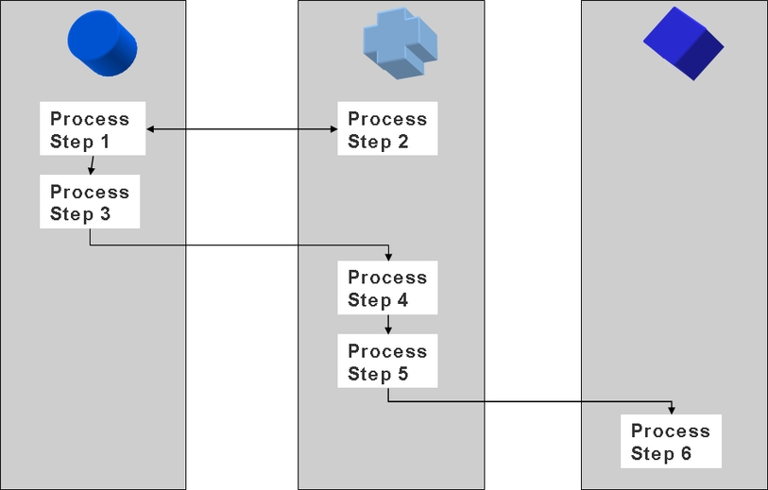
Business Process in a distributed landscape
Before starting an PI Integration project, a component view of the business process requirements must be established

Slide 4
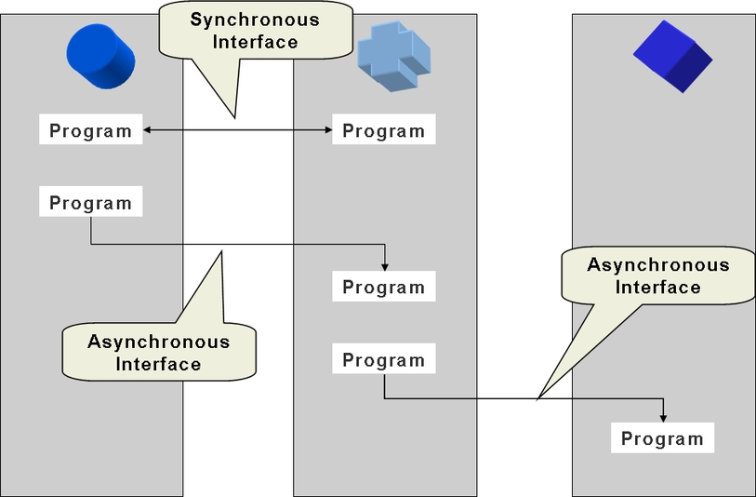
External interfaces in a distributed landscape
PI Integration is interface-driven. An interface represents:
The transfer of data between two components
Synchronous or asynchronous message exchange

Slide 5
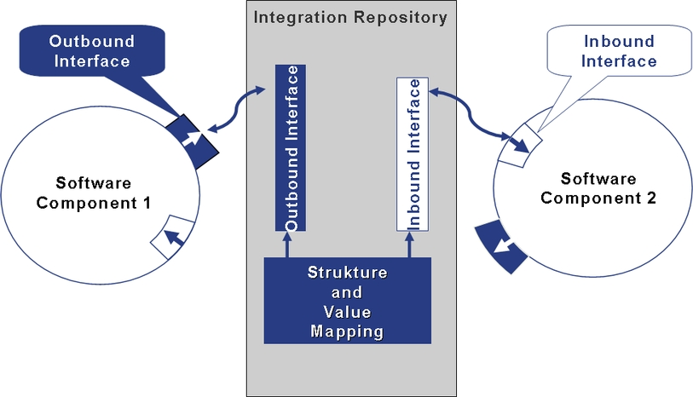
Software Components, interfaces and mappings

Slide 6
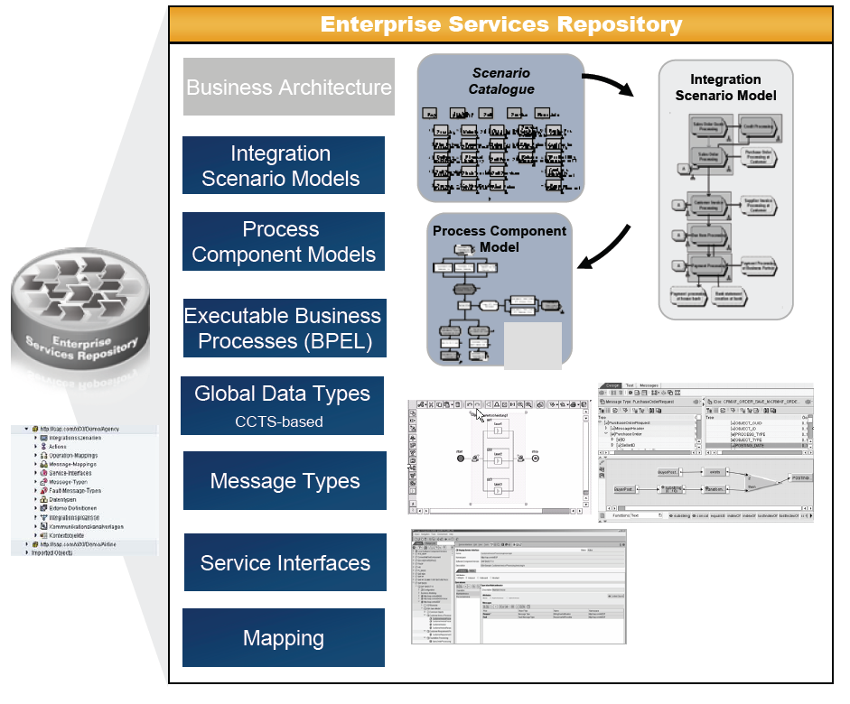
ES REPOSITORY OBJECTS

Slide 7
Evolution Of XI Repository into ES Repository
XI Repository is now the foundation for central services repository.
Stores Metadata of IDOC ,RFCs AND Service definitions.
Global Data Types in addition to Free style data types.
Free style data types, core data types and aggregated data types are part
of ESR.
Implicitly enforcing design time governance
Objects organized by Software Component Versions and Namespaces.
Setup of naming conventions for better management.
Contract first interface design.
Interface documentation.
Supports open standards.

Slide 8
Enterprise Service Repository
Agenda
PI7.1 Enterprise Service Repository
Overview and concepts
Software components and namespaces
Interface objects
Mapping objects

Slide 9
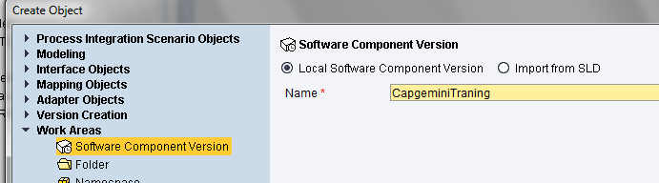
Software component version
Primary container for all Enterprise Service Repository objects
Imported directly from the SLD
Usage dependencies from SLD are reflected in the Repository (‘Basis objects‘)
For each software component version, the following can be assigned:
A connection to an existing SAP system
for the import of IDoc/RFC interfaces
One or more namespaces

Slide 10
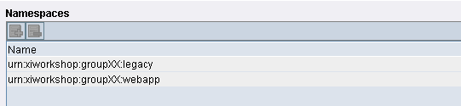
Namespaces
(Globally) unique identifier for related Enterprise Service Repository objects
Usually vendor-based
Same concept as XML namespaces
Several namespaces can be assigned to the same SWCV
Naming convention:
URL http://sap.com/xi/demo
URN urn:sap-com:xi:demo
(URL without protocol assignment)

Slide 11
Enterprise Service Repository
Agenda
PI 7.1 Enterprise Service Repository
Overview and concepts
Software components and namespaces
Interface objects
Mapping objects

Slide 12
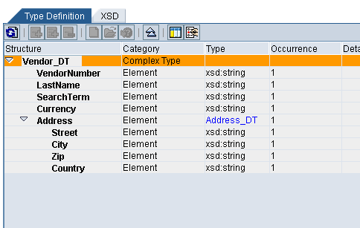
Interface Objects: Data type
Data types are the most basic entity to define the structure of XML elements
Equivalent to XML Schema (XSD)
Data type editor provides all XSD basic data types.
Nesting of data types possible
Export of data type in XSD format possible

Slide 13
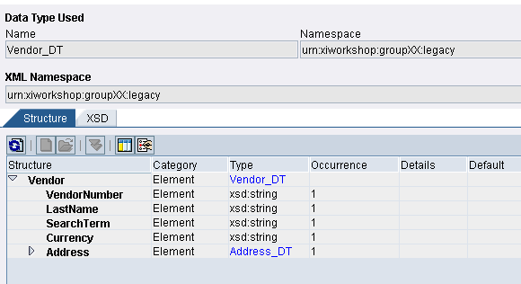
Interface Objects: Message type
The Message type corresponds to the root of the XML message
Name and namespace must match exactly the root of XML Business documents
The Message type references one single data type
XSD representation available for export

Slide 14
Interface Objects: Service Interface
The Service Interface is the highest-level representation of XML metadata.
Inbound or outbound (respective to the application), or abstract (for BPM only)
Synchronous or asynchronous
Asynchronous refers to one message type
Synchronous refers to two message types (request and response)
References fault message types for exception handling
WSDL representation available for export
Starting point for proxy generation (ABAP and Java)
Context objects can be assigned
Constructed with message types, data types, RFC or IDoc metadata and
external definitions.
Describes single or multiple operations to be implemented.
Types of Interface Patterns are stateless, stateless (XI 3.0-compatible),
stateful and tu&c/c.
Operation patterns depend on the interface pattern eg. Normal, confirm etc

Slide 15
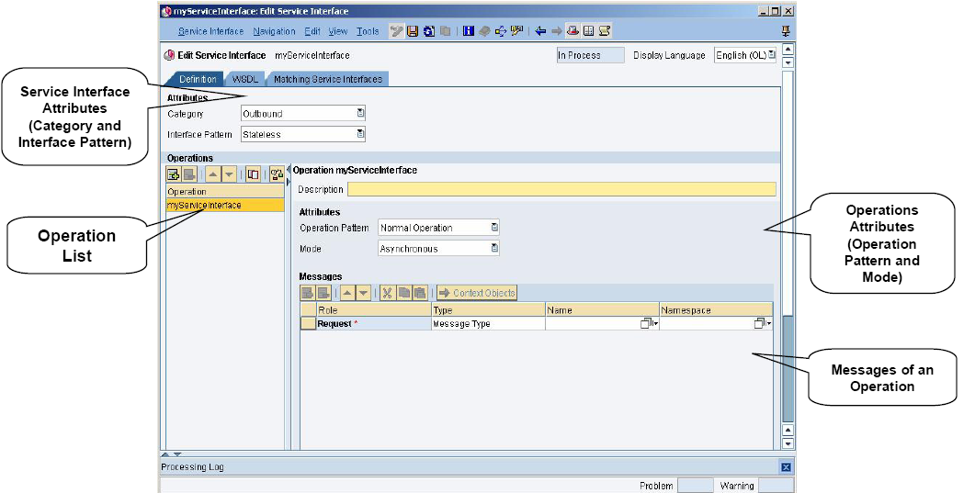
Service Interface : UI Layout

Slide 16
Service Interface : Interface Pattern
Interface pattern describes the type of communication that is to be executed in the message.
Stateless : Messaging runtime does not support saving the status of
message once message exchange has been executed successfully.
Stateful : Messaging runtime supports saving the status of message once
message exchange has been executed successfully.
TU&C/C : Tentative Update and Confirm/Compensate provides reliable
means of providing synchronous call updates in a transactional context.
Operations: Single or multiple operations can be specified.
Operation Pattern: Depends on the interface pattern.
Mode: Asynchronous/Synchronous.

Slide 17
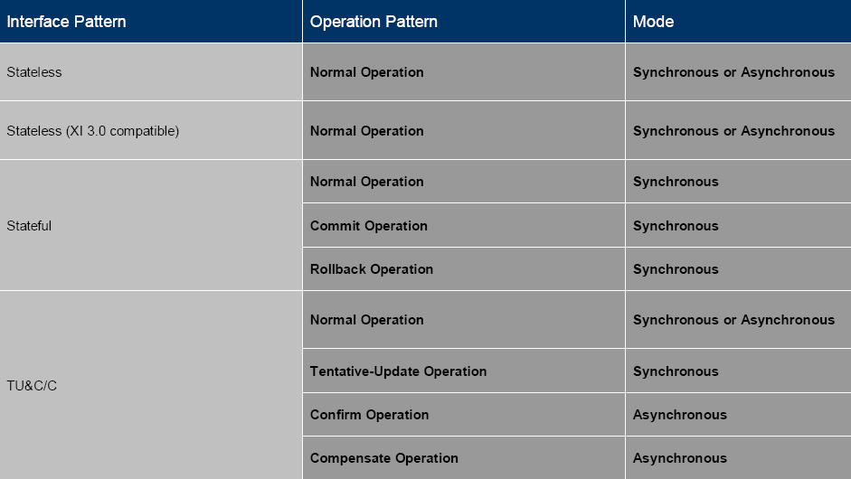
Interface Pattern and Operations Pattern
Each interface pattern has specific operation patterns and modes.

Slide 18
Enterprise Service Repository
Agenda
PI 7.1 Enterprise Service Repository
Overview and concepts
Software components and namespaces
Interface objects
Mapping objects

Slide 19
Mapping concepts
Mapping
Transformation from one message structure to another
Transformation rules defined by mapping program
Value Mapping
<hh:book-flight xmlns:hh="...">
<hh:customer>
<hh:first-name>Micheal</hh:first-name>
<hh:surname>Moore</hh:surname>
</hh:customer>
<hh:booking-data>
<hh:airline>Airline Kingdom</hh:airline>
<hh:connection>AK087</hh:connection>
<hh:date>2001-11-22</hh:date>
<hh:class>business</hh:class>
</hh:booking-data>
</hh:book-flight>
<ak:BookFlight xmlns:ak="...">
<ak:Date>22.11.2001</ak:Date>
<ak:Flight>087</ak:Flight>
<ak:Passenger>Micheal Moore</ak:Passenger>
<ak:Class>2</ak:Class>
<ak:Agency>Happy Holiday</ak:Agency>
</ak:BookFlight>
Structure Mapping

Slide 20
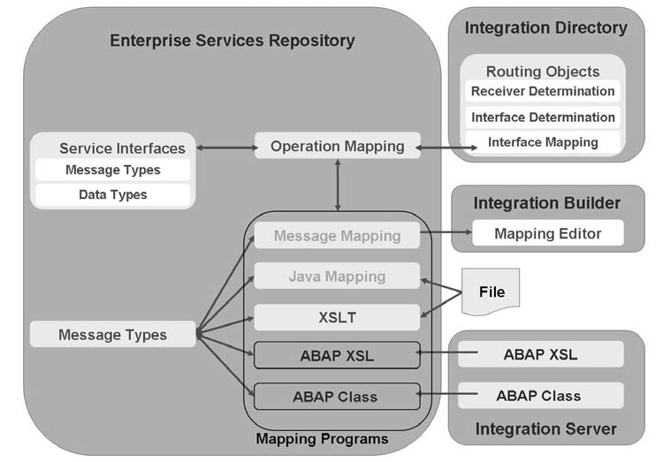
Mapping Objects in SAP NetWeaver PI

Slide 21
Mapping concepts
At design time, the mapping is defined in the Enterprise Services Repository in terms of operation mappings.
Operation mappings connect two (or more) service interfaces with one another.
Mapping programs used to map other mapping objects (mapping programs) to implement the mapping between the message types. message types can be realized in the following different ways:
Message mappings: are created graphically using the mapping editor in the Integration Builder.
Java mappings: are created externally and then imported.
XSL transformations: are created externally and then imported.
ABAP-XSL transformations are created and referenced on the Integration Server (in the ABAP stack).
ABAP mapping classes are created and referenced on the Integration Server (in the ABAP stack).

Slide 22
Mapping Objects: Message mapping
Graphical mapping tool
Graphically define mapping rules between source and target message types
Queue-based model allows for handling of extremely large documents
Drag-and-drop
Generates internal Java code
Built-in and user-defined functions (in Java)
Integrated testing tool

Slide 23
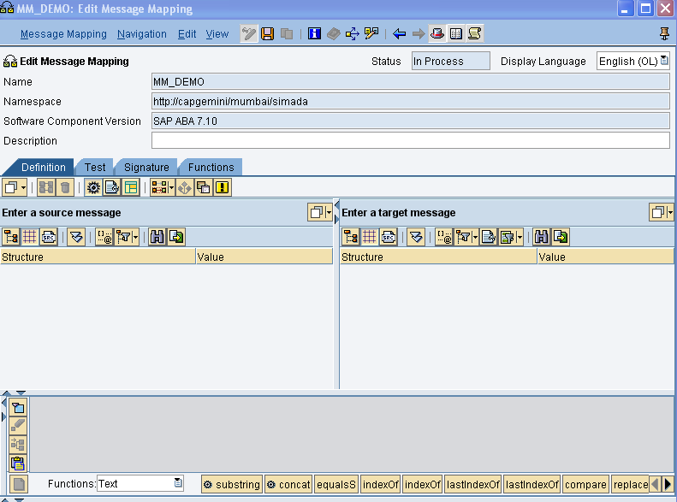
Message Mapping: Mapping Editor
In message mapping, different message structures are mapped to each other.
Define parameters for parameterized message mapping
Object Tool Bar
Define function Libraries
Source Structure
Target Structure
Structure Overview
Standard Function list
Data Flow Editor

Slide 24
Main Function Area of the Mapping Editor:
Signature: To define parameters for parameterized mapping.
Function: To create Function library so that UDF’s are globally available.
Object Toolbar :The functions in the Object Toolbar relate to the entire
mapping. For example, you can save your mapping or automatically assign
fields with the same name to each other.
Structure Overview: Import an XML or XSD file for both the source
structure and the target structure.
Data-Flow Editor: Describe the flow of data from one or more source fields.

Slide 25
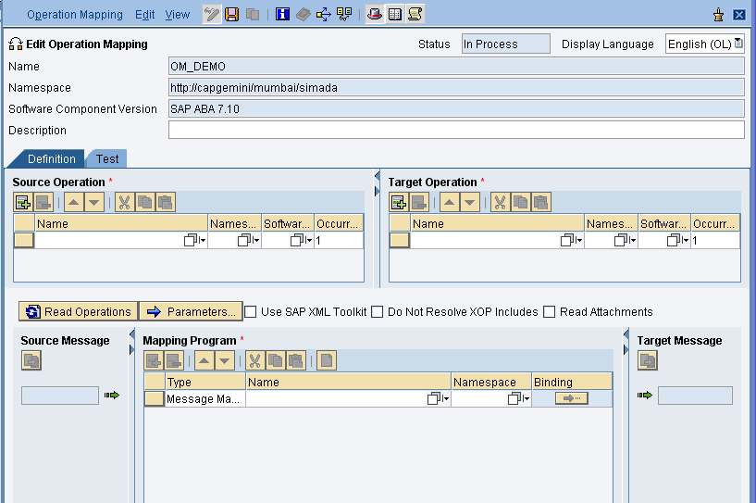
Mapping Objects: Operation Mapping
Perform several mapping programs for the transformation of a request
or response message.
For synchronous service interfaces, a request and response mapping
can be provided.
Define parameter in parameter messages mapping
Bind parameter in parameter messages mapping
Basic Setting

Slide 26
Mapping objects: imported archives
The object type ‘imported archive’ is for importing externally defined programs into the Enterprise Service Repository:
XSLT stylesheets
Java mappings
Java extensions to XSLT mappings
Java classes to be imported in a user-defined function for message mapping
All files to be imported must be archived (ZIP or JAR format)
The archive is uploaded from user workstation.
Enterprise Service Repository can serve as central maintenance location for imported objects
XSLT and text files can be edited directly from IR.
Java CLASS files must be edited and recompiled locally, then re-imported.

Slide 27
SAP Exchange Infrastructure
Introduction
1
2
Application Environment
3
Demonstration
4
Hands On
5
HelpMe

Slide 28
Enterprise Service Repository Demo
ESR Demo

